Slide 1
News about C-SRNWP
ACCORD ASM, 13 April 2026
Christoph Schraff, C-SRNWP Module Manager, DWD

Slide 2
C-SRNWP: Organization
DWD: coordinating member for C-SRNWP (& co-managing SRNWP-EPS)
Christoph Schraff remains (temporal) Module Manager
Vanessa Schlidt joined on Eumetnet contract in July and was planned to take over as permanent Module Manager after transition phase, but left DWD again on her own wish end Feb. 2026
→ procedure for recruitment of a replacement not yet defined
Georgia (LEPL National Environment Agency) is a new cooperating NHMS of EUMETNET,
participating a.o. in E-WFC incl. C-SRNWP, SRNWP-EPS, …

Slide 3
C-SRNWP: Organization
discussion on role and structure of C-SRNWP Expert Teams continues
ETs are still needed
transversal projects / working groups to collaborate on “hot topics” (e.g. hectometric scale modeling)
AI: more collaboration with E-AI
→ invite E-AI representative to report on EWGLAM meetings on a regular basis?
under discussion: new ET on data handling? (replacing ET’s link with application, system aspects?)
ET chairs:
ET VER (diagnostics, validation and verification): Marion Mittermaier replaced by
Rachel North (UK Met Office)
New vacant ET Chairs: – ET-DA (Data Assimilation and Use of Observations)
– ET-SURF (Surface and soil processes (model and data assimilation))

Slide 4
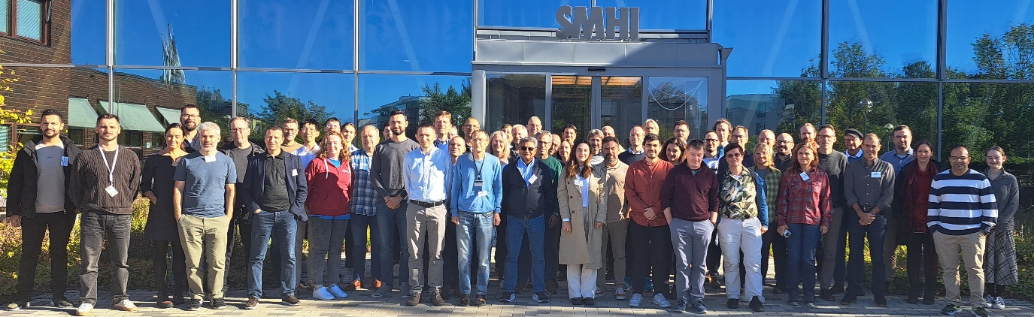
C-SRNWP_1 (exchange of information):
EWGLAM Meeting 2025: 22 – 25 Sept.
in Norrköping, Sweden, hosted by SMHI
participants: 80 in person + 76 remote, from > 80 % of C-SRNWP members, positive feedback
special topic: “Navigating the Future of High-Resolution NWP:
Embracing AI, Sub-Kilometer Scales, and the Evolution of HPC”
3 invited talks (stretched grid or LAM MLWP; hectometric NWP; E-AI);
consortia talks; 7 thematic + 4 parallel sessions; posters etc.
available on https://www.srnwp.eu/content/annualMeetings/2025/default.htm :
all presentation slides, recordings, posters, agenda, list of participants
final discussion: how to verify ML-WP and compare with NWP
(physical, inter-variable, temporal consistencies; scales;
choice of scores to show added value of other method, etc.)

Slide 5
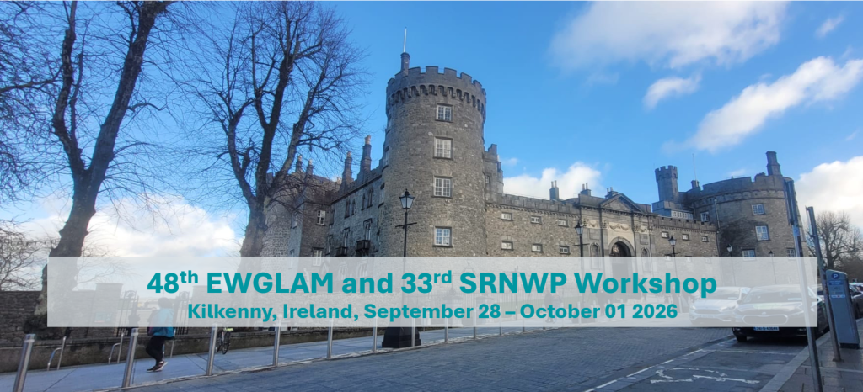
C-SRNWP_1 (exchange of information): EWGLAM Meeting 2026
28 Sept. – 1 Oct. 2026,
kindly hosted by Met Éireann
in Kilkenny, hybrid format
Special topic: “Verifying the Future: Intercomparison of ML and NWP Models”
(choice of methods, metrics, variables, …, consistencies, scales)
Deadline for online registration & submitting proposals for talks / posters
on https://met.ie/ewglam2026 : 1st June 2026
(no travel funding any more for participants from C-SRNWP Members States)

Slide 6
C-SRNWP: exchange of info / organization
WG 1 | AI Data Readiness & Data Curation (e.g. Data Sets Preparation & Managem., Standards, IPR, Labellng) | active
WG 2 | LLM Implementation and Services | active
WG 3 | AI Operationalisation, Maintenance & QC, MLOps | active
WG 4 | AI Sensing & Novel Obs – with EMN OBS Programme | starting
WG 5 | AI-based Info Condensation & Communication, AI-based HIW Warnings, Personalisation | with WG2
WG 6 | Nowcasting – jointly with E-NWC | active
WG 7 | AI in the Aviation Support Programme (CBCF) | active
WG 8 | Ethics Questions | active
WG 9 | AI Frameworks | with WG3
WG10 | Data Rescue – jointly with EMN Climate Programme | active
WG11 | Regional Downscaling for Climate Impact Analysis – jointly with EUMETNET Climate Programme | active
WG12 | QC – jointly with EUMETNET Climate Programme | active
WG13 | Data Fusion and PostProcessing (PP) | active
ATS | Anemoi Technical Subgroup (ATS) | active
DTG | DAWID Technical Subgroup (DTS) | starting
idea to create
joint E-AI – C-SRNWP Working Group on
verification / evaluation / intercomparison
of ML-WP and NWP model forecasts
  under the roof of E-AI
  (2 –) 3 ‘facilitators’ (experts mainly in verification), role to be defined
WG’s in E-AI

Slide 7
C-SRNWP_1: exchange of information
ObsSET Meeting (4 – 5 June 2025) with participation of C-SRNWP MM (online)
Schraff: “novelties and issues linked to the use of observations in LAM NWP models”
→ SRNWP community:
requests for more wind-optimized radar scans and better metadata transparency and harmonized radar quality control across countries,
has interest in expanding the use of multi-network surface observations,
requests an improved access to crowd-sourced data
→ PFAC proposes to fund (from ‘surplus’) development of unified OPERA quality index
→ PFAC proposes to fund one-off development towards operational PWS Service in 2027 (IoT)
(Netatmo, InfoClimat, MeteoNetwork – 300,000+ PWS stations; QC flags; …)
(far more (additional!) funding required for continuous operational PWS Service!)

Slide 8
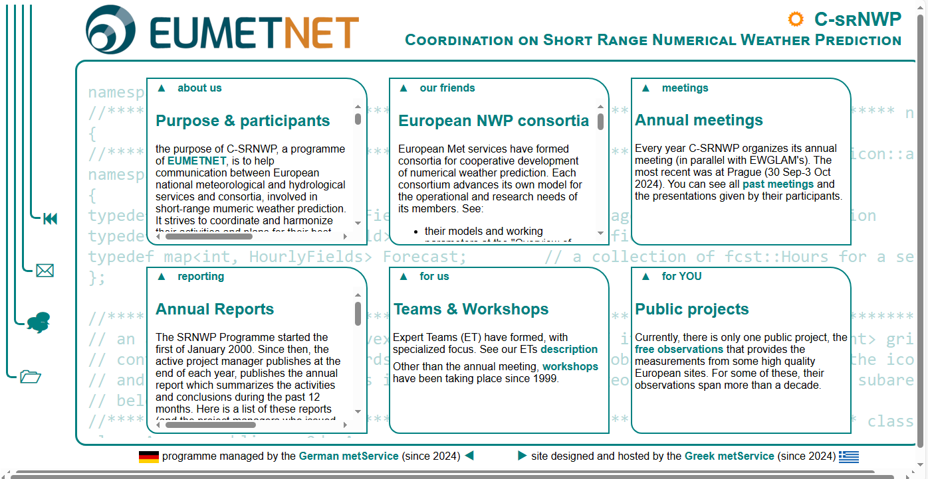
C-SRNWP_1: web site of C-SRNWP: www.srnwp.eu
info on operational NWP configs partly updated;
working units to be updated
List of contact points updated
updated
frozen
ET to be updated
ok
→ 1 year ago: needs to be updated

Slide 9
C-SRNWP_2: maintaining & developing “resources”
EUMETNET funding for ‘infrastructure costs’ in C-SRNWP (8500 € / y)
maintenance of Global Lake Data Base (GLDB), developed in previous programme phase:
further maintained at ECMWF (Margarita Choulga a.o.),
and the data are available at ECMWF for member states,
or on request via zip files for C-SRNWP members

Slide 10
C-SRNWP_2: maintaining & developing “resources”
EUMETNET funding for ‘infrastructure costs’ in C-SRNWP (8500 € / y)
ML-based development of decametric (60m) land cover physiography
with ECOCLIMAP-SG land use / land cover labels over Europe
(using ML to combine several existing datasets with different resolution)
at FMI, with EUMETNET (C-SRWNP) funding from 2024 + 2025
→ an updated dataset itself is produced and validated,
report available (“Physiography report 2026” by Rudolf Mård),
dataset yet to be uploaded (where? Zenodo platform?)
next years? Physiography dataset is useful for ACCORD, but not directly for e.g. COSMO;
for better understanding: produce list of physiographic parameters in ECOCLIMAP and
overlap with param. used in other consortia (J. Helmert, P. Samuelsson)
→ currently undetermined

Slide 11
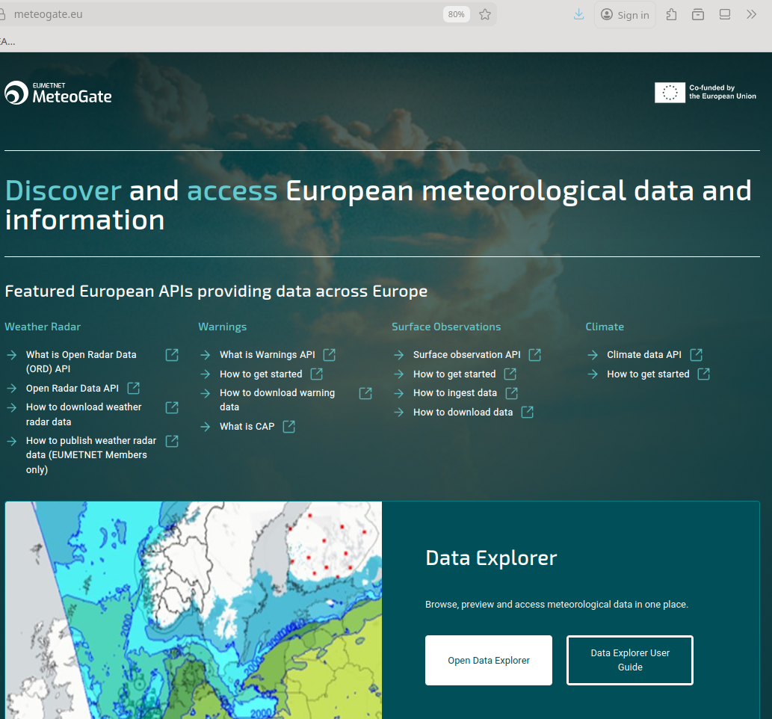
https://meteogate.eu
Eumetnet: MeteoGate
operational centralized European one-stop-shop platform designed to harmonize & facilitate access to meteorol. & hydrol. data from NMS’s
(infrastructure developed by EUMETNET
to help NMS’s to share their data
NWP products yet to be added:
opportunity! (no obligation)
(but obligation to fulfill EU HVD regulation)
C-SNRWP PoC informed (email 08.04.26)
Plan to include engagement of
ECMWF & EUMETSAT as Data Providers
docu how to publish data: https://eumetnet.github.io/meteogate-documentation/3-publishing-data/ .
discussion forum: https://github.com/orgs/Meteogate/discussions

Slide 12
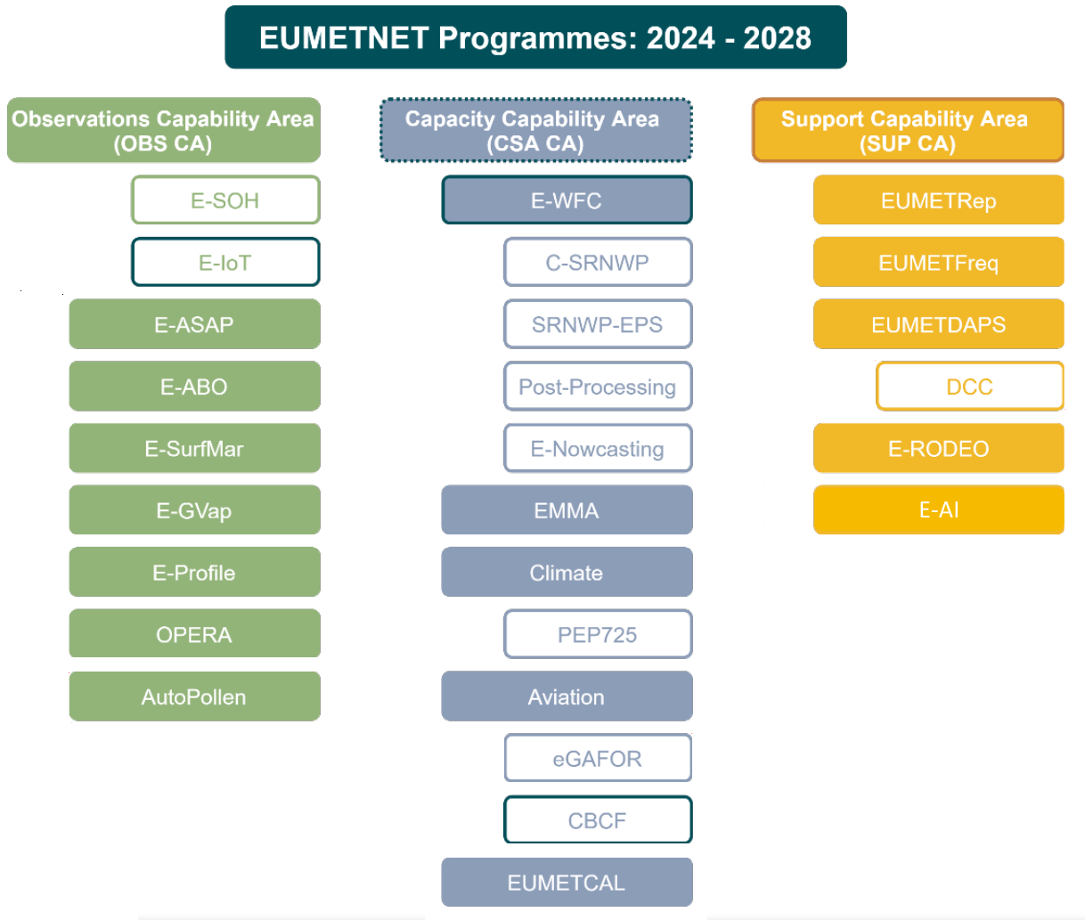
Eumetnet
• Strengths: collaboration; shared costs (e.g. obs);
networking; operational aspects
• Limitations: diversity of membership, limited agility,
decision making; limited resources, …
• Challenges: AI (#1 concern) & rapid technolog. changes,
private sector engagement,
maintain / consolidate authoritative voice
+ national mandates
• Ambition: share efforts, infrastructures
• Legacy: maintain EUCOS which requires significant effort
• UKMO + M-F: keeping impactful (marine) observations is highest priority
• AI as prime example for ‘collaboration, not only coordination’ (E-AI, MLPP)
• which alternative obs types (crowd-sourced, opportunistic, IoT, commercial, …)
should be prioritized?

Slide 13
ANY QUESTIONS?

Slide 14
Christoph Schraff
C-SRNWP module manager
Phone: +49 69 8062 2725
Email: christoph.schraff@dwd.de

